Slide 1
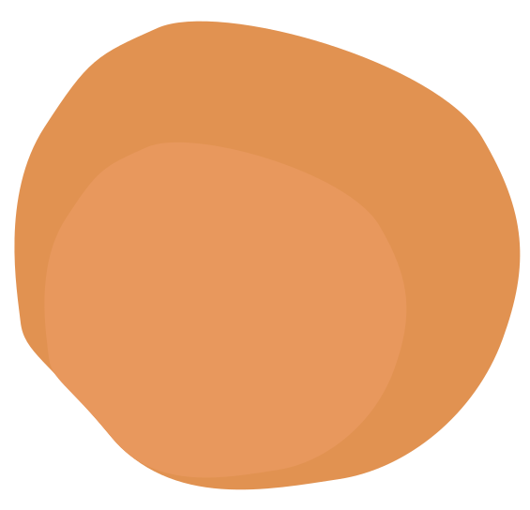


PRACTICE DESIGNING ALGORITHMS
Group 13
Đỗ Quang Lực - 23520902
Nguyễn Minh Huy - 23520634
Instructor: Nguyễn Thanh Sơn

Slide 2
Scoring
Do exercises on Wecode: 70%
Participate in discussion: 10% / person
Positive discussion points: 10% + bonus 🤤

Slide 3
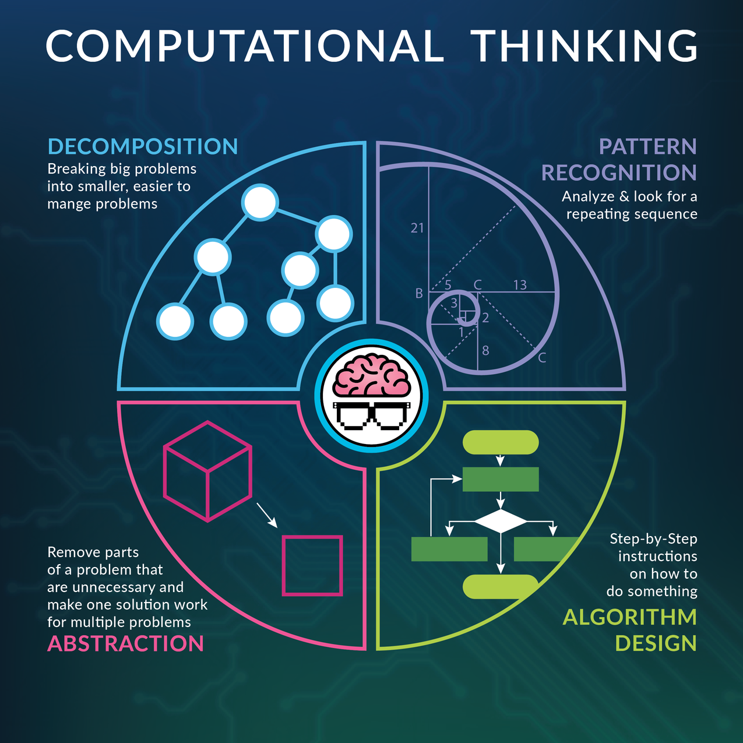
Recall computational thinking

Slide 4
Algorithm design methods
Brute force, Backtracking, Branch and Bound
Greedy approach
Divide, Decrease, Transform and Conquer
Dynamic programming
...

Slide 5
Applied to algorithm design
Distributed algorithms
Geometry
Graph
Game theory
...

Slide 6
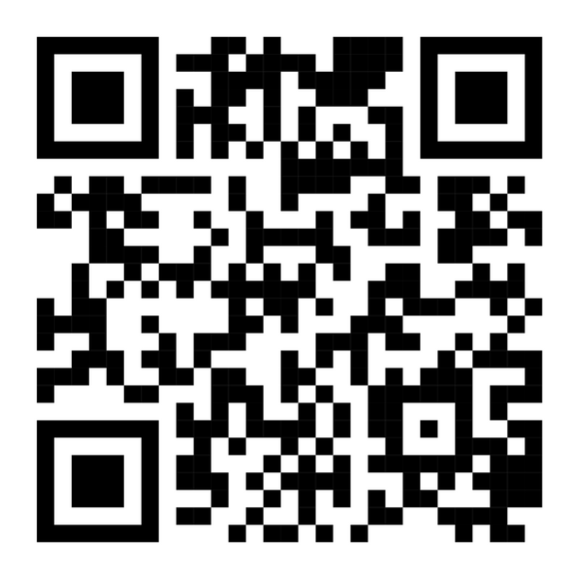
Problem 1
COOK
(20 points)

Slide 7


Summary
Given array a consisting of m elements, array b consisting of n elements and a positive integer k. Find the maximum number of pairs a[i], b[j] that are combined together, satisfying:|a[i] - b[j]| <= k
m, n ≤ 200000
0 ≤ k ≤ 10^9
1 ≤ a[i], b[i] ≤ 10^9
Example:
k = 5
60
45
80
60
30
60
75

Slide 8
Approach
Which algorithm design method can we choose?
A. Dynamic Programming
B. Divide and conquer
C. Transform and conquer
D. Backtracking

Slide 9
Algorithm design
Example 1: After sorting we get:
Given m = 2, n = 2, k = 2
a[] = {1, 2}
b[] = {3, 5}
What is the maximum number of pairs we can match?
A. 1
B. 2
C. 0
D. 3

Slide 10
Algorithm design
Example 2: After sorting we get:
Cho m = 4, n = 3, k = 1
a[] = {1, 2, 3, 5}
b[] = {3, 4, 6}
What is the maximum number of pairs we can match?
A. 1
B. 2
C. 4
D. 3

Slide 11
Algorithm design
Conclusion: The pairs will be paired in consecutive order, the smallest a[i] will be paired with the smallest b[j] that satisfies, and this continues until the end of the sequence.
Greedy

Slide 12
Conclude
This problem is quite complicated as it requires 2 steps:
Transform and conquer
Greedy

Slide 13
Problem 2
MINE
(30 points)

Slide 14
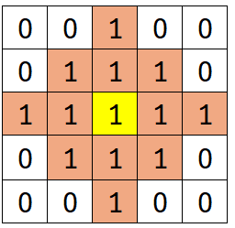
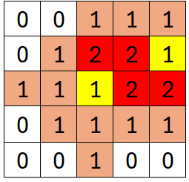
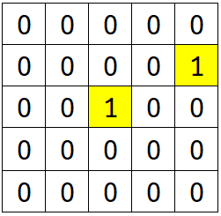
Summary
Given a table of size m x n, each cell contains information about the bombs around it (called table a)
Each bomb will explode with a range of manhattan = 2. The requirement is to find the positions of the bombs in the table.
There are no two bombs in the same cell, each table has exactly 1 way to place the bombs accordingly
m, n ≤ 16

Slide 15
Algorithm design
Greedy?
Approach?
Status?
Manage what?
Dynamic programming?
Divide/Decrease/Transform Conquer?
?
Consider all states of the table using backtracking

Slide 16
Backtrack
Consider all the bomb states of the table, check if they are the same as the original information table.
With a maximum of 16 x 16 cells, the number of states will be 2^256
Backtracking optimization: using branches and bounds

Slide 17
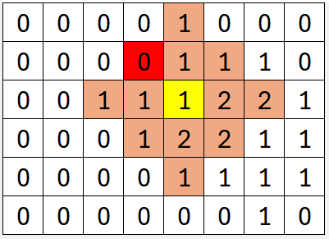
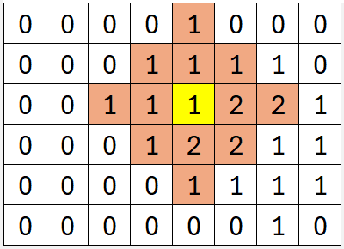
Branch & Bound
Bound 1. If the current location cannot place a bomb, do not place.
Can’t place bomb on yellow squares
Can place bomb on yellow squares

Slide 18
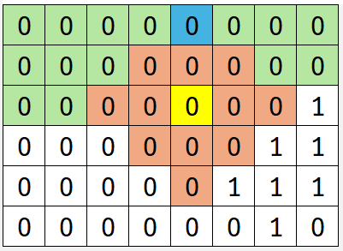
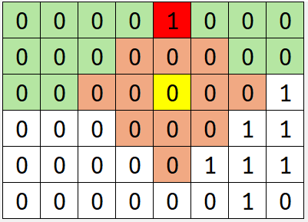
Branch & Bound
Bound 2. After considering cell (i, j), the state of cell (i - 2, j) must be 0.
After considering the state of the yellow cell, no other cell can affect the blue cell.
Continuing to consider states after the yellow box is pointless -> significantly reduces the number of states

Slide 19
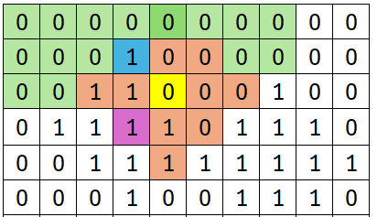
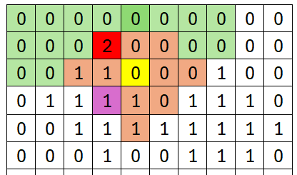
Branch & Bound
Bound 3: After considering cell (i, j), the state of cell (i - 1, j - 1) must be less than 2
After considering the state of the yellow square, only one purple square remains that can affect the blue square.
We have to consider (n - 1) more cells to decide that this table is invalid for bound 2
-> Bound 3 reduces the state a lot

Slide 20
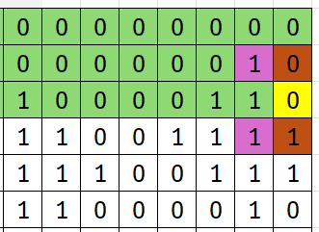
Branch & Bound
Bound 3.2: After considering cell (i, n), the state of cell (i - 1, n) must also be less than 2

Slide 21
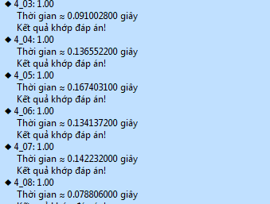
Time complexity
Difficult to calculate specifically
Reality: algorithm runs about 0.1 - 0.17 seconds

Slide 22
Problem 3
FLOWER
(20 points)

Slide 23
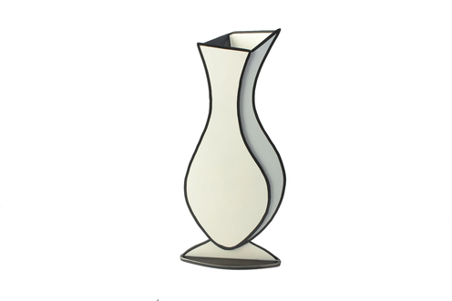

Summary
Given n vases numbered from 1 to n and k flowers numbered from 1 to k. We have a[i][j] is the brilliance when flower j is placed in vase i. You must put the flowers in the vase in ascending order from 1 to n and the order of the flowers is also ascending so that the total brilliance is maximum.
In other words, you need to find a sequence of n positive integers c_i satisfying: 1≤c[1]<c[2]<...<c[n]≤k so that: A[1][c[1]] + A[2][c[2]] + ... + A[n][c[n]] is the largest.
n ≤ k ≤ 5000
a[i][j] ≤ 10000

Slide 24
Approach
Which algorithm design method can we choose?
A. Dynamic Programming
B. Divide and conquer
C. Transform and conquer
D. Backtracking

Slide 25
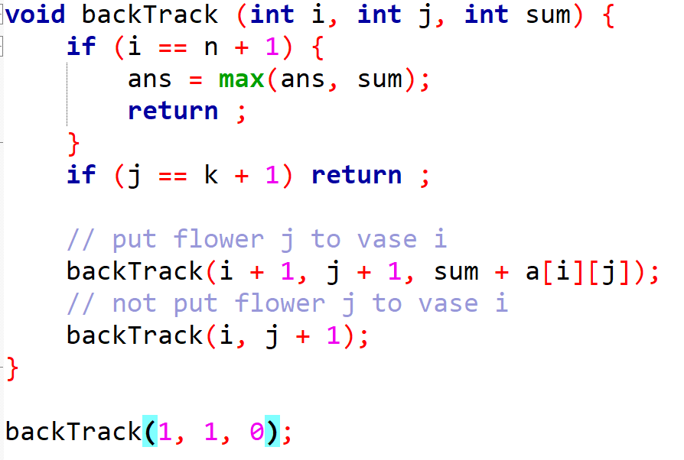
Backtrack

Slide 26
Dynamic programming
Let call dp[i][j]: the maximum value at vase i, flower j
dp[i][j] + a[i + 1][j + 1]
dp[i + 1][j + 1]
dp[i][j]
dp[i][j + 1]
answer = max(dp[n][j])

Slide 27


